Slide 1

CS50x Final Project
Hamza A.
Austin, Texas, USA

Slide 2

Basic Concept:
Side-scrolling shoot ’em up.
Endless; game ends when you game over.
Levels get progressively harder, with enemies increasing in number and difficulty.

Slide 3
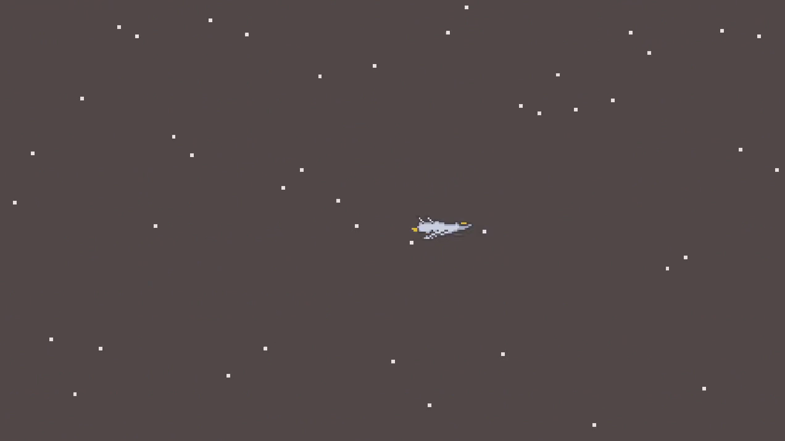
Gameplay
Arrow keys to move, space bar to shoot.
After each level, you get the option to upgrade one of the spaceship’s traits: ATK (attack), HP (health), or SPD (speed).
Since the levels get progressively harder, it’s crucial that you upgrade your traits after each level.

Slide 4

Gameplay – Part 2
Additional Controls: Enter -> Pause/Unpause Escape -> Exit Game
Special boss enemies appear every 5 levels.

Slide 5
The End
Thank you for watching!

